Slide 1
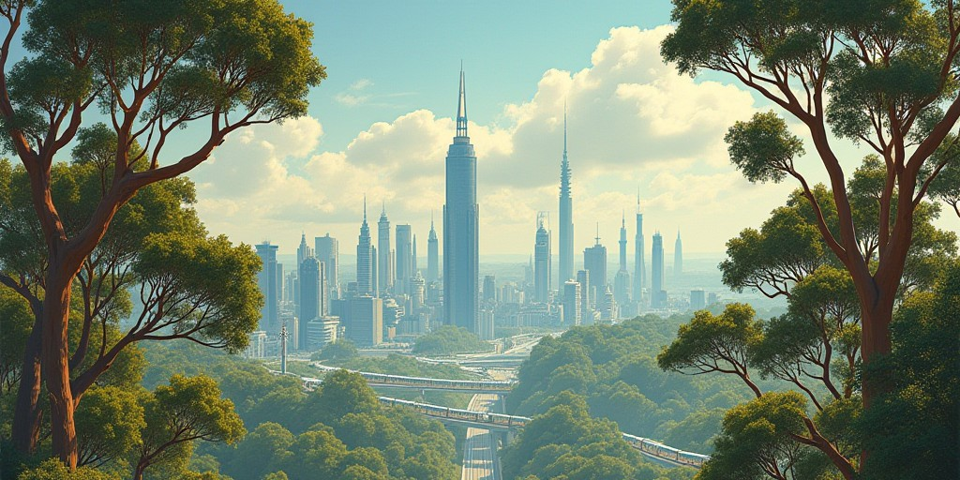
Greener Canberra
For a 100% sustainable capital city

Slide 2
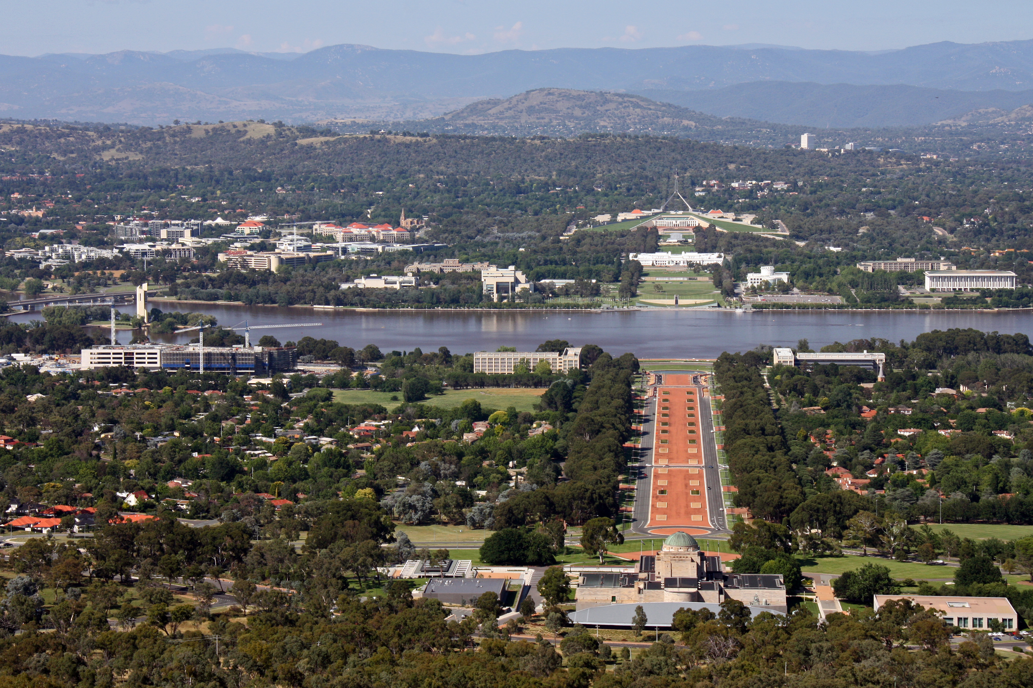
Canberra today
General informations:
Country : Australia
Population : 450k
Per capita emissions : 3.5 tons of CO2 in 2023
100% renewable energy in 2020, 2021, and 2022

Slide 3
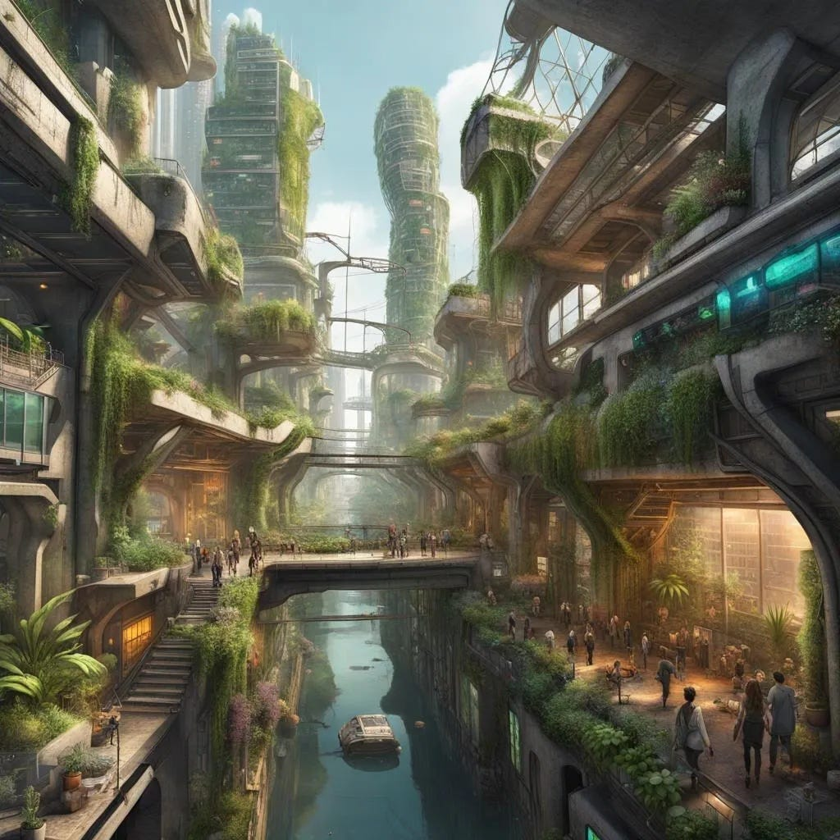
Our project
Style inspiration : «Solarpunk»
Goal : 100% sustainable and autonomous city
Low carbon transportation
Energy-efficient buildings
More enjoyable urban life
Good looking city

Slide 4
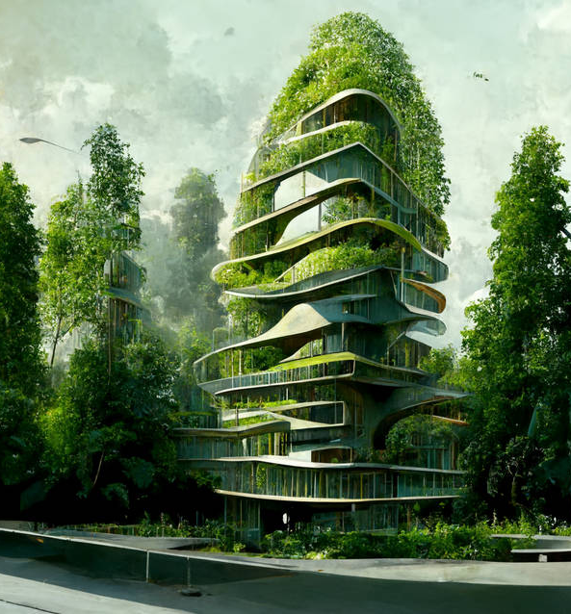
Buildings
Materials : stone and mud bricks, wood, bamboo
Walls and top covered with plants help regulate temperature, humidity and air quality
Optimal orientation for max sunlight inside

Slide 5
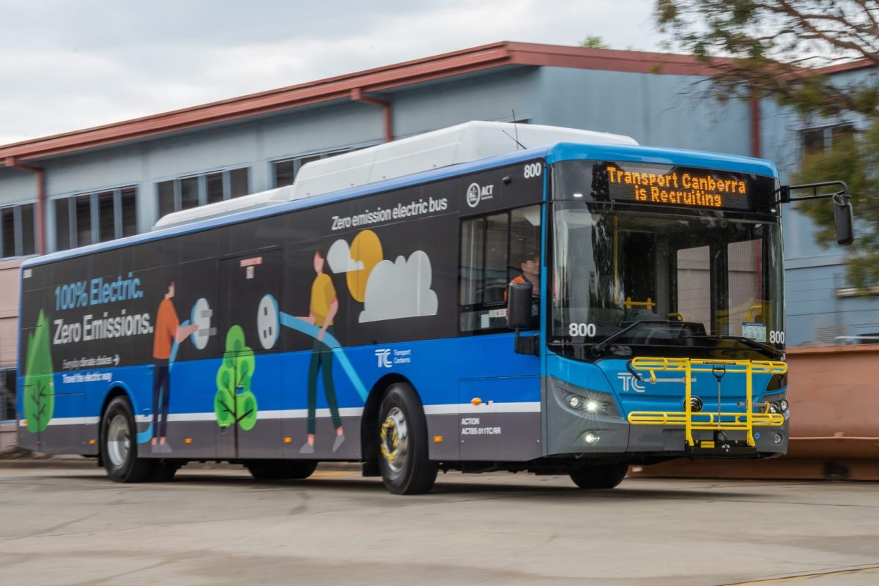
Transportation
Walking : wider sidewalks and crosswalks, more walk-only areas
Cycling : more bicycle ways, public bicycles available for cheap rent
Buses and tramways : cheap low-carbon public transportation, 100% electric
Private cars : not allowed in the city

Slide 6
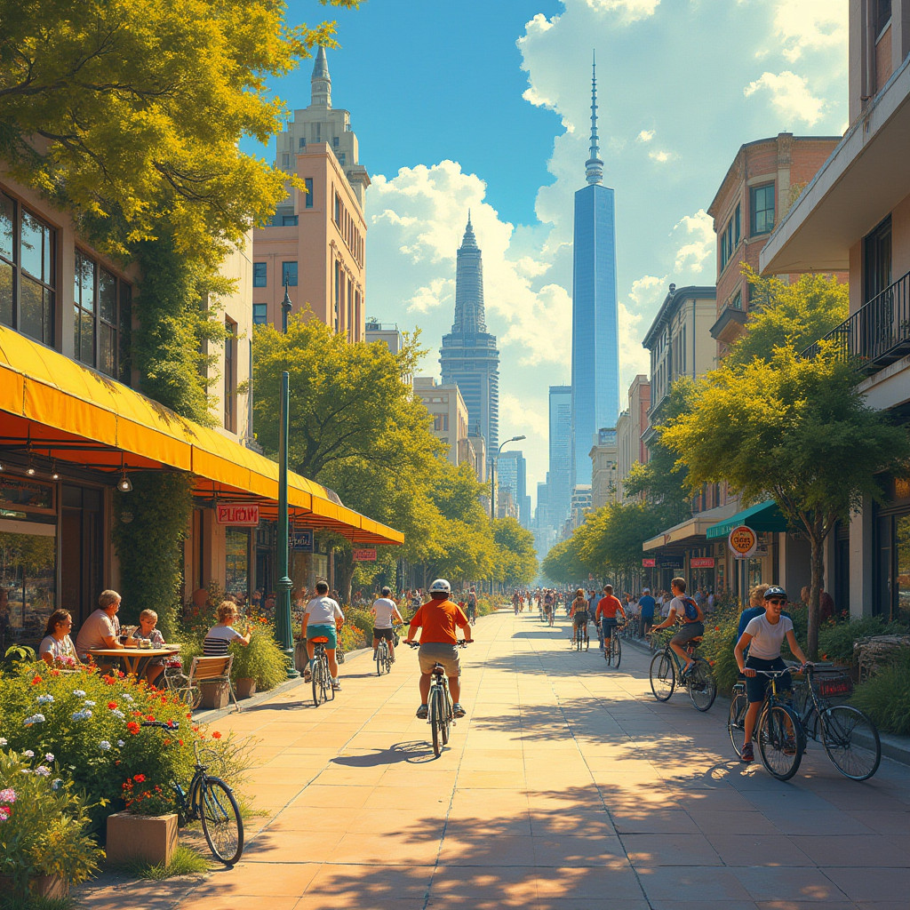
Shops and groceries
Less giant supermarkets
More small proximity shops for buying food and everyday life stuff
Every inhabitant must have a shop within 10 minutes of walking

Slide 7
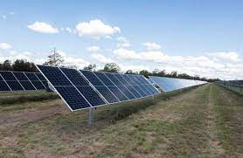
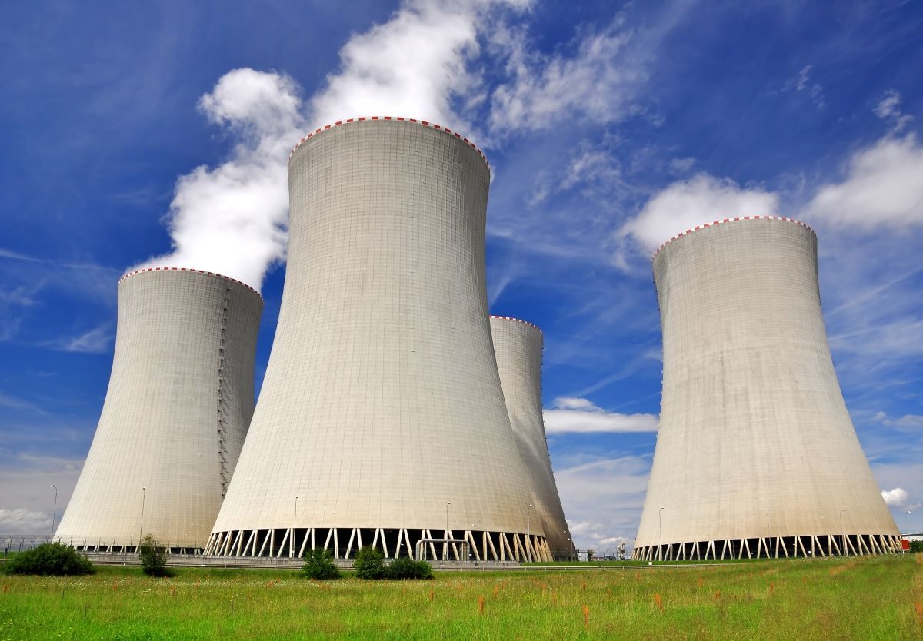
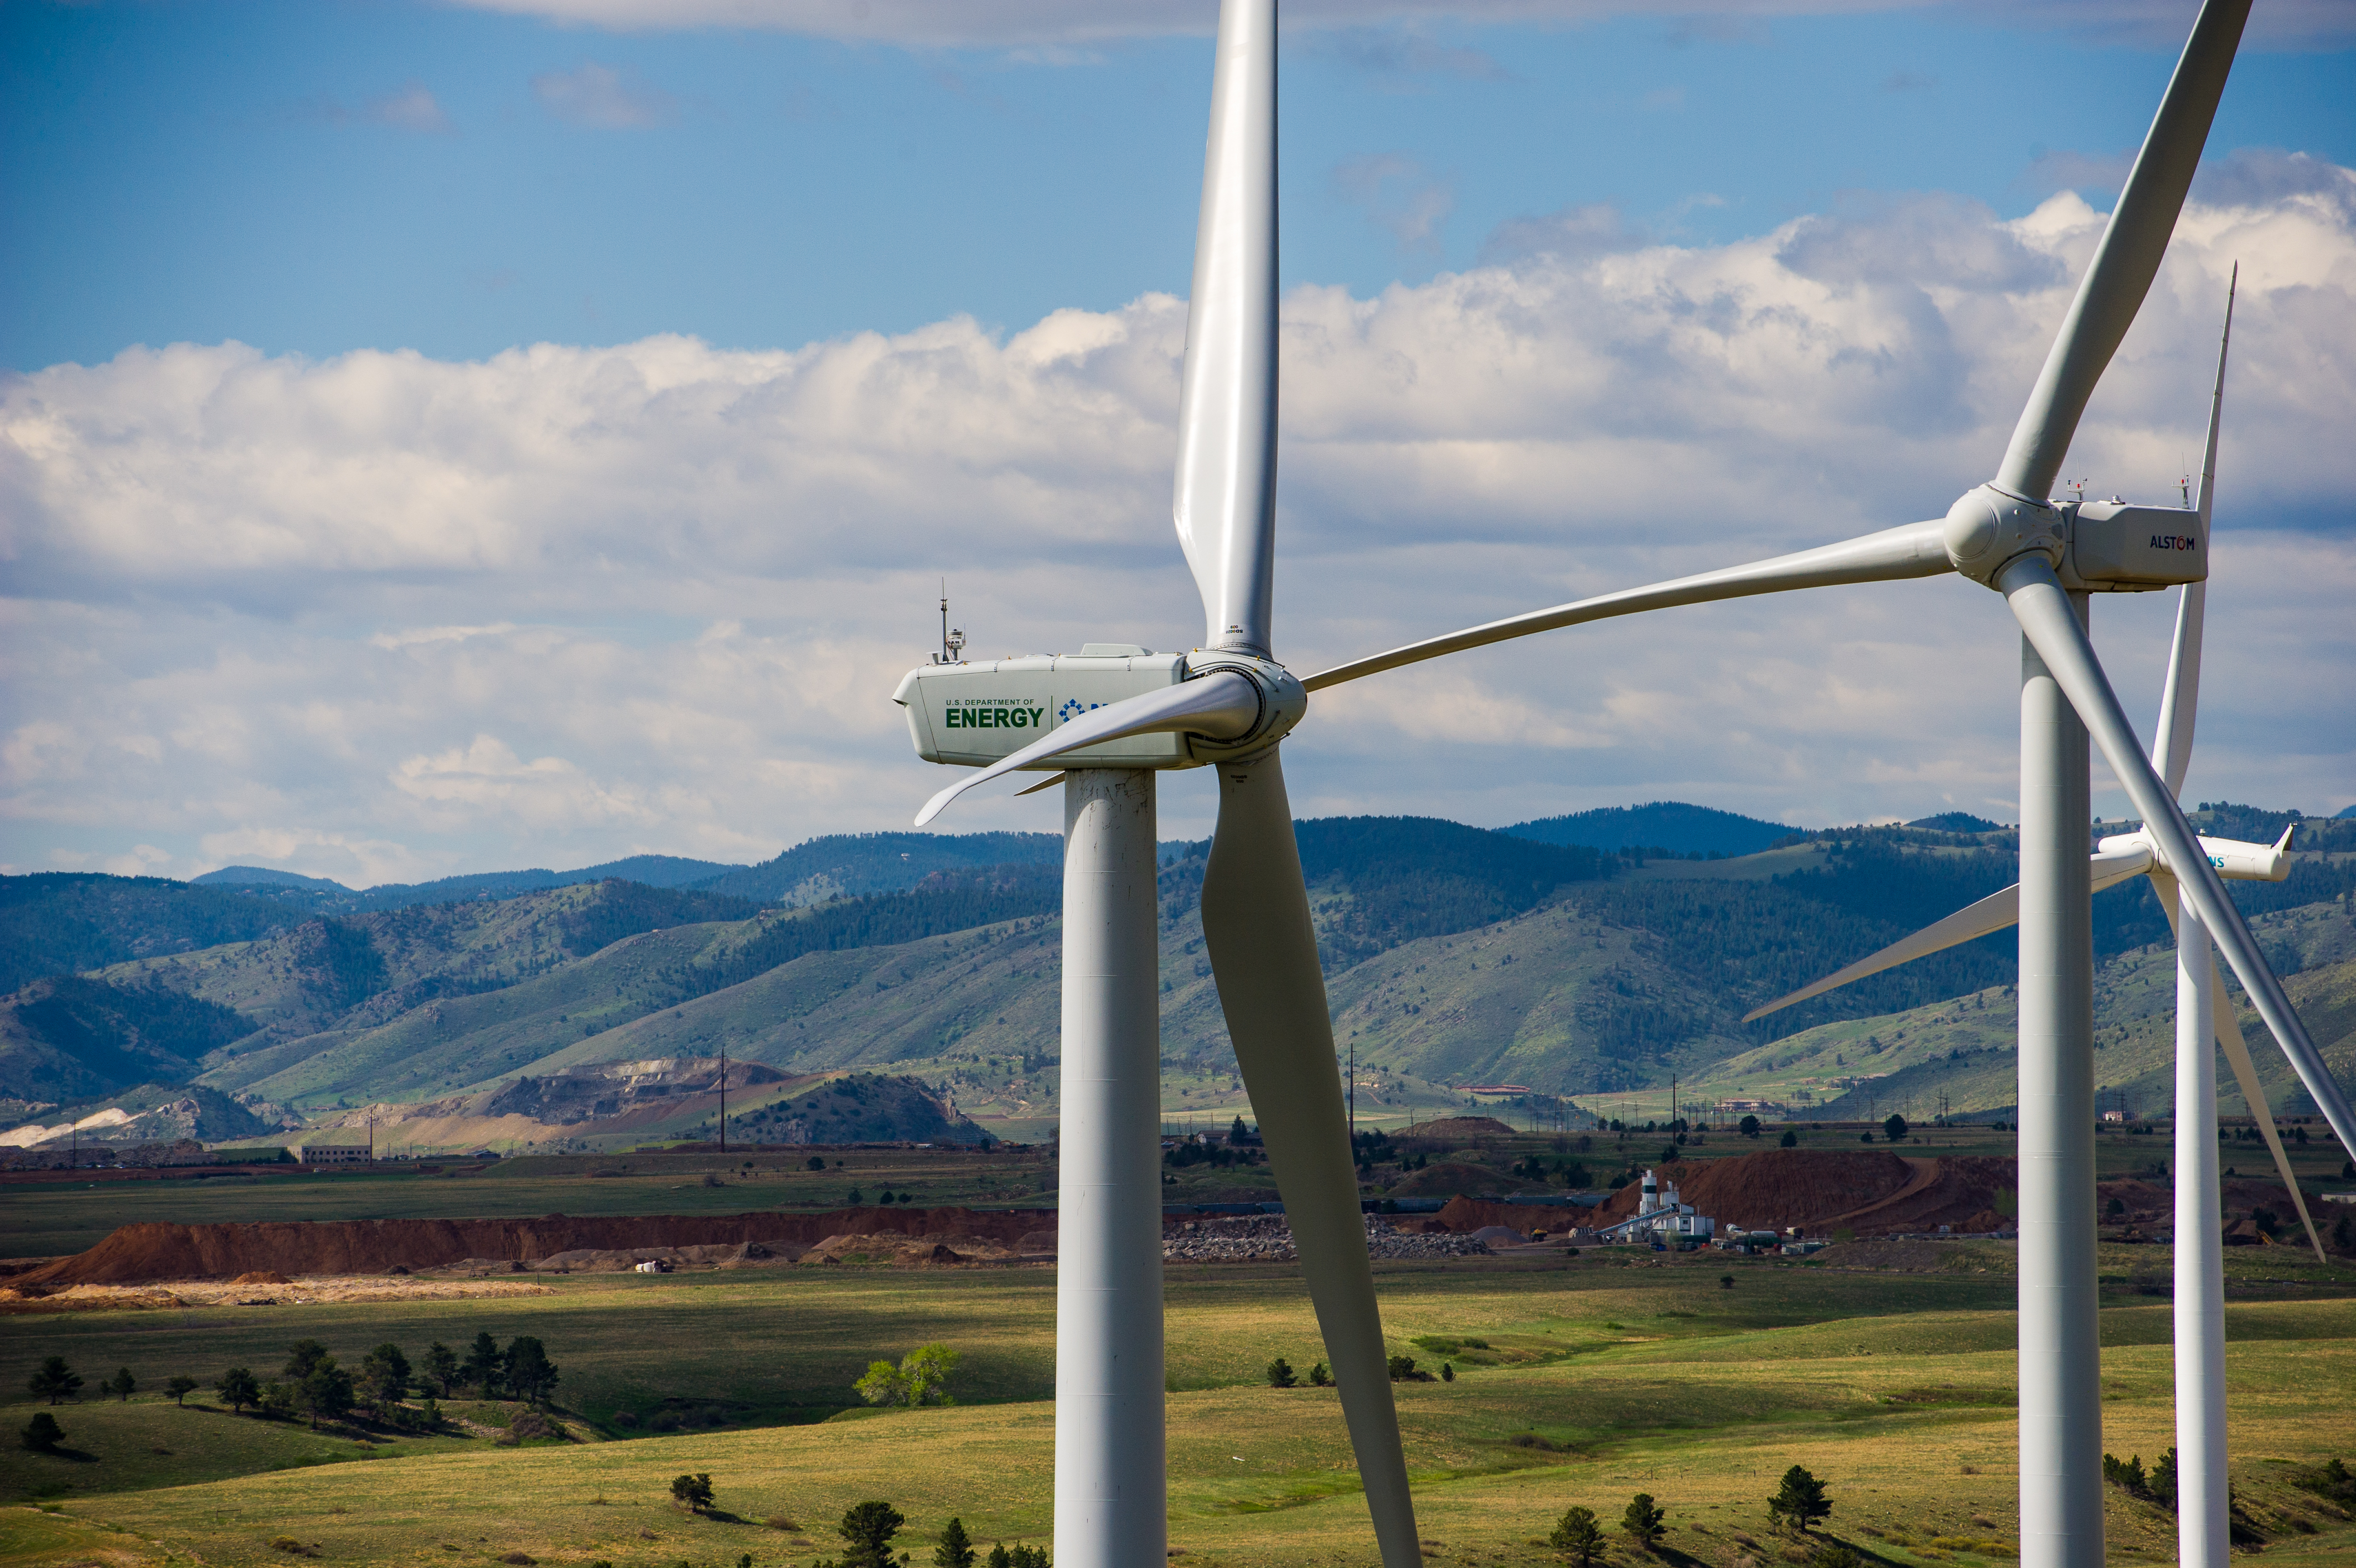
Energy production
100% renewable energy goal
Solar and wind energy
Nuclear energy to sustain the transition without CO2 emission

Slide 8
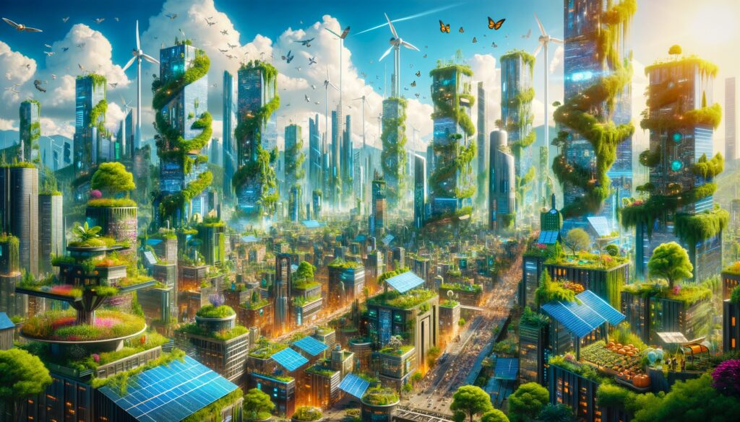
Thank you for your attention

